Slide 1
Contextualization and
Church-planting

Slide 2
Contextualization
is inevitable
is biblical
is hard work done together
Church-planting
is disciple making
is urgent
is a biblical church growth strategy

Slide 3
Exercise
Feedback?

Slide 4
Contextualization
is inevitable
The method yes but the message?
Good definition(s)?

Slide 5
Contextualization is not — as is often argued — “giving people what they want to hear.” Rather, it is giving people the Bible’s answers, which they may not at all want to hear, to questions about life that people in their particular time and place are asking, in language and forms they can comprehend, and through appeals and arguments with force they can feel, even if they reject them.

Slide 6
Sound contextualization means translating and adapting the communication and ministry of the gospel to a particular culture without compromising the essence and particulars of the gospel itself. The great missionary task is to express the gospel message to a new culture in a way that avoids making the message unnecessarily alien to that culture, yet without removing or obscuring the scandal and offense of biblical truth.

Slide 7
A contextualized gospel is marked by clarity and attractiveness, and yet it still challenges sinners’ self-sufficiency and calls them to repentance. It adapts and connects to the culture, yet at the same time challenges and confronts it. If we fail to adapt to the culture or if we fail to challenge the culture — if we under- or over contextualize — our ministry will be unfruitful because we have failed to contextualize well.
Keller, Timothy J. Center Church

Slide 8
Contextualization
is inevitable
The method yes but the message?
Good definition(s)?
Over and under . . .

Slide 9
Contextualization
is inevitable
is biblical
Grounds for C:
Missio Dei
Sensus Divinitatus
Cultural Mandate The Gospel(s)
The Example
The Boundaries

Slide 10
Contextualization
is inevitable
is biblical
is hard work done together

Slide 11
Contextualization
is inevitable
is biblical
is hard work done together
Church-planting
is disciple making
is urgent
is a biblical church growth strategy

Slide 12
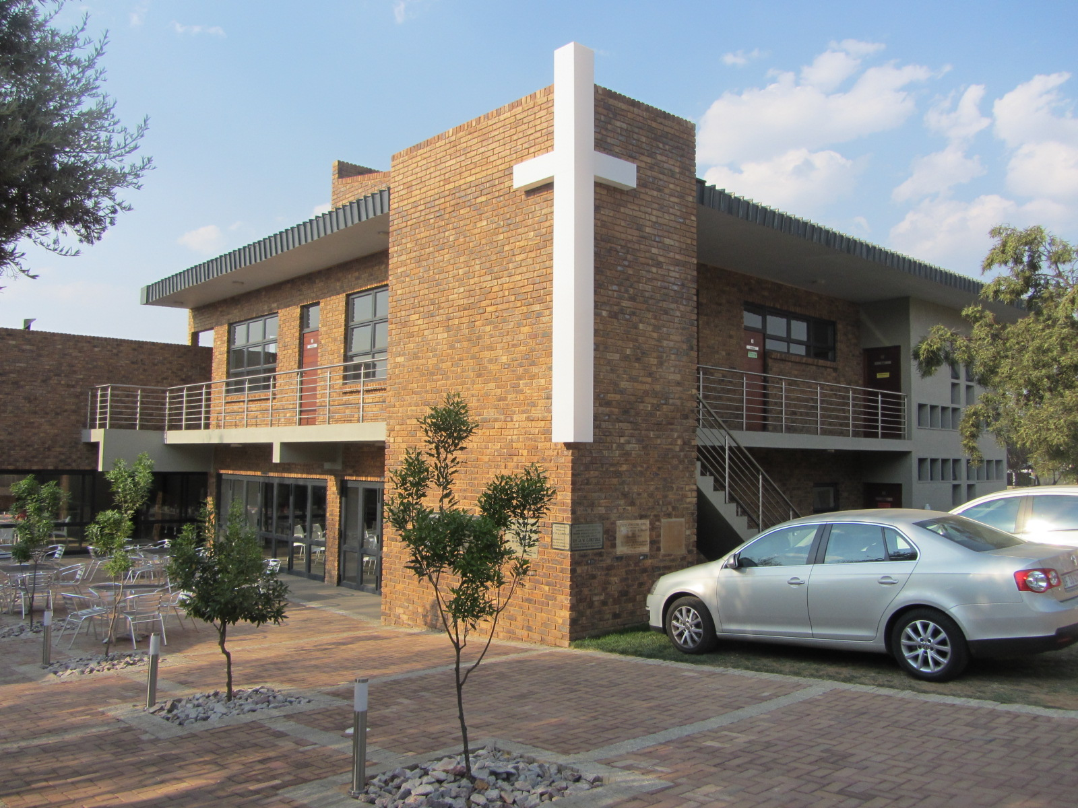

Slide 13
Contextualization
is inevitable
is biblical
is hard work done together
Church-planting
is disciple making

Slide 14
Matthew 28
¹⁸ And Jesus came and said to them, “All authority in heaven and on earth has been given to me. ¹⁹ Go therefore and make disciples of all nations, baptizing them in the name of the Father and of the Son and of the Holy Spirit, ²⁰ teaching them to observe all that I have commanded you. And behold, I am with you always, to the end of the age

Slide 15
Matthew 28
¹⁸ And Jesus came and said to them, “All authority in heaven and on earth has been given to me. ¹⁹ Go therefore and make disciples of all nations, baptizing them in the name of the Father and of the Son and of the Holy Spirit, ²⁰ teaching them to observe all that I have commanded you. And behold, I am with you always, to the end of the age

Slide 16
Matthew 28
¹⁸ And Jesus came and said to them, “All authority in heaven and on earth has been given to me. ¹⁹ Go therefore and make disciples of all nations, baptizing them in the name of the Father and of the Son and of the Holy Spirit, ²⁰ teaching them to observe all that I have commanded you. And behold, I am with you always, to the end of the age

Slide 17
Matthew 28
¹⁸ And Jesus came and said to them, “All authority in heaven and on earth has been given to me. ¹⁹ Go therefore and make disciples of all nations, baptizing them in the name of the Father and of the Son and of the Holy Spirit, ²⁰ teaching them to observe all that I have commanded you. And behold, I am with you always, to the end of the age

Slide 18
Contextualization
is inevitable
is biblical
is hard work done together
Church-planting
is disciple making
is urgent

Slide 19
God in our time is moving climactically through a variety of social, political, and economic factors to bring earth’s peoples into closer contact with one another, into greater interaction and interdependence, and into earshot of the gospel. By this movement God carries forward his redemptive purposes in history. A sign of our time is the city. Through worldwide migration to the city God may be setting the stage for Christian mission’s greatest and perhaps final hour. Keller, Timothy J. Center Church:

Slide 20
Contextualization
is inevitable
is biblical
is hard work done together
Church-planting
is disciple making
is urgent
is a biblical church growth strategy

Slide 21
Romans 15
¹⁷ Therefore I glory in Christ Jesus in my service to God. ¹⁸ I will not venture to speak of anything except what Christ has accomplished through me in leading the Gentiles to obey God by what I have said and done— ¹⁹ by the power of signs and miracles, through the power of the Spirit. So from Jerusalem all the way around to Illyricum, I have fully proclaimed the gospel of Christ.

Slide 23
Younger adults are disproportionately found in new congregations.
New residents are better reached by new congregations.
New social groups are better reached by new congregations.
The average new church gains most of its new
members (60-80%) from the ranks of people who are not attending any worshipping
body, while churches over 10-15 years of age gain 80-90% of new members by transfer.

